Slide 1
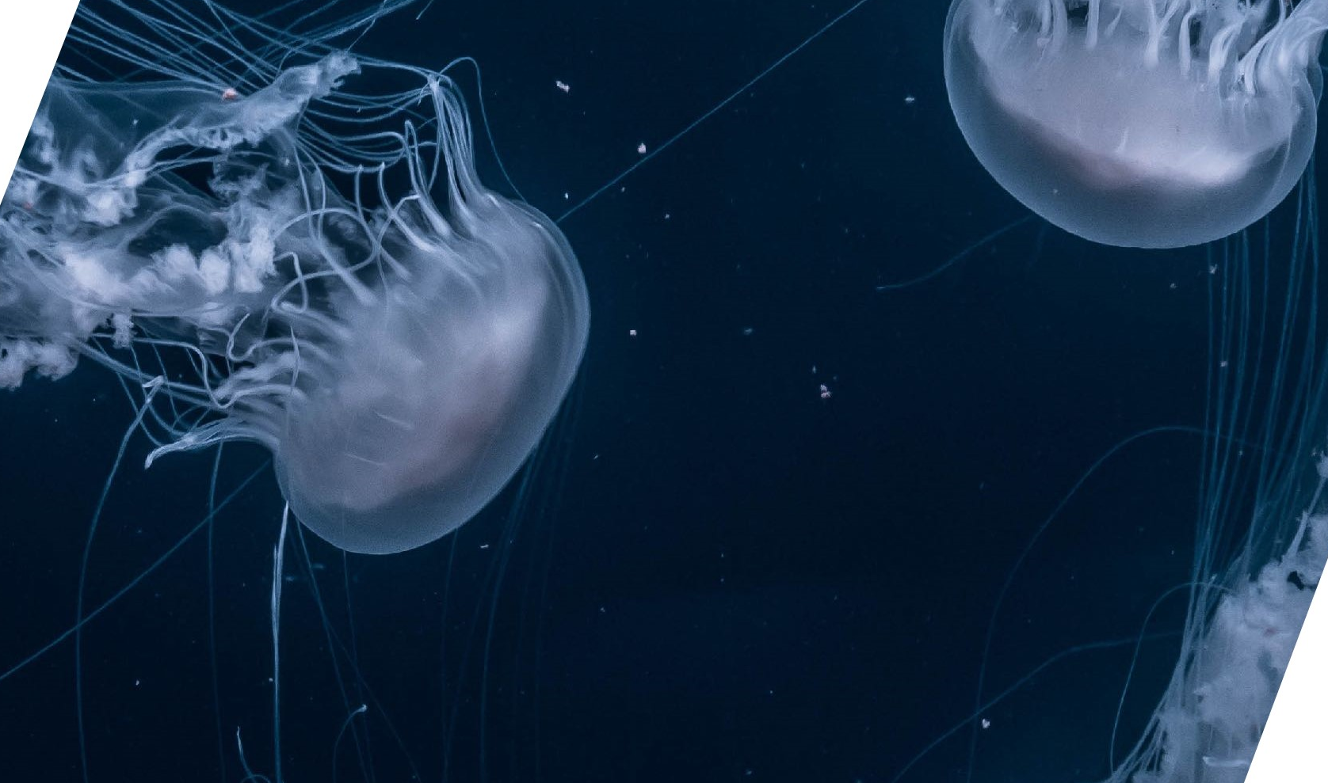
Mini–Project 1
Face Recognition
Attendance Management System
PRESENTED BY:
Abhishek Sharma
Deepak Raj
Ayush Goel
Ashish Varshney

Slide 2
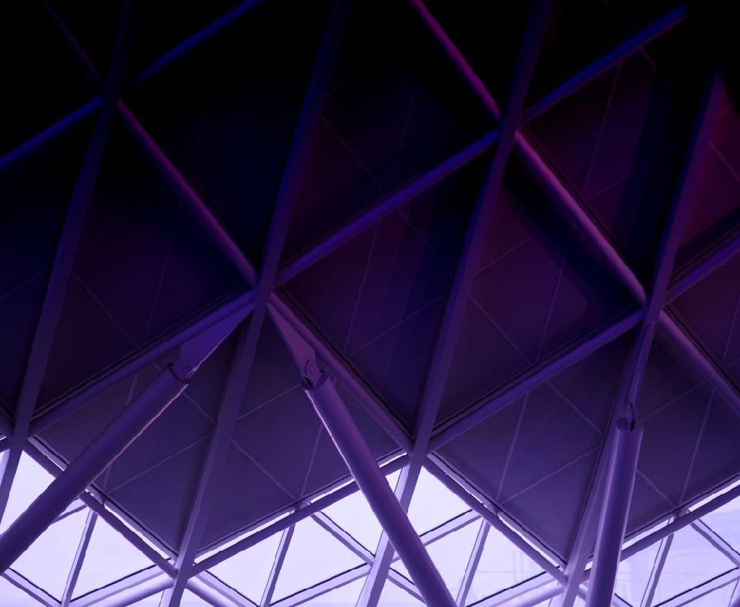
Table of Contents
Problem
Solution
Our
Services
Features & Operations
Tools Used
SECTION THREE
Reason
Goals and Vision
Code
Application

Slide 3
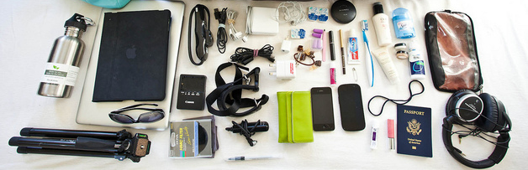
Describing the Problem
What’s the Main Problem?
It all started with the same experience which lead us to figure out, how big is the problem?
We the students getting more lethargic everyday and are getting late for attending college day by day

Slide 4
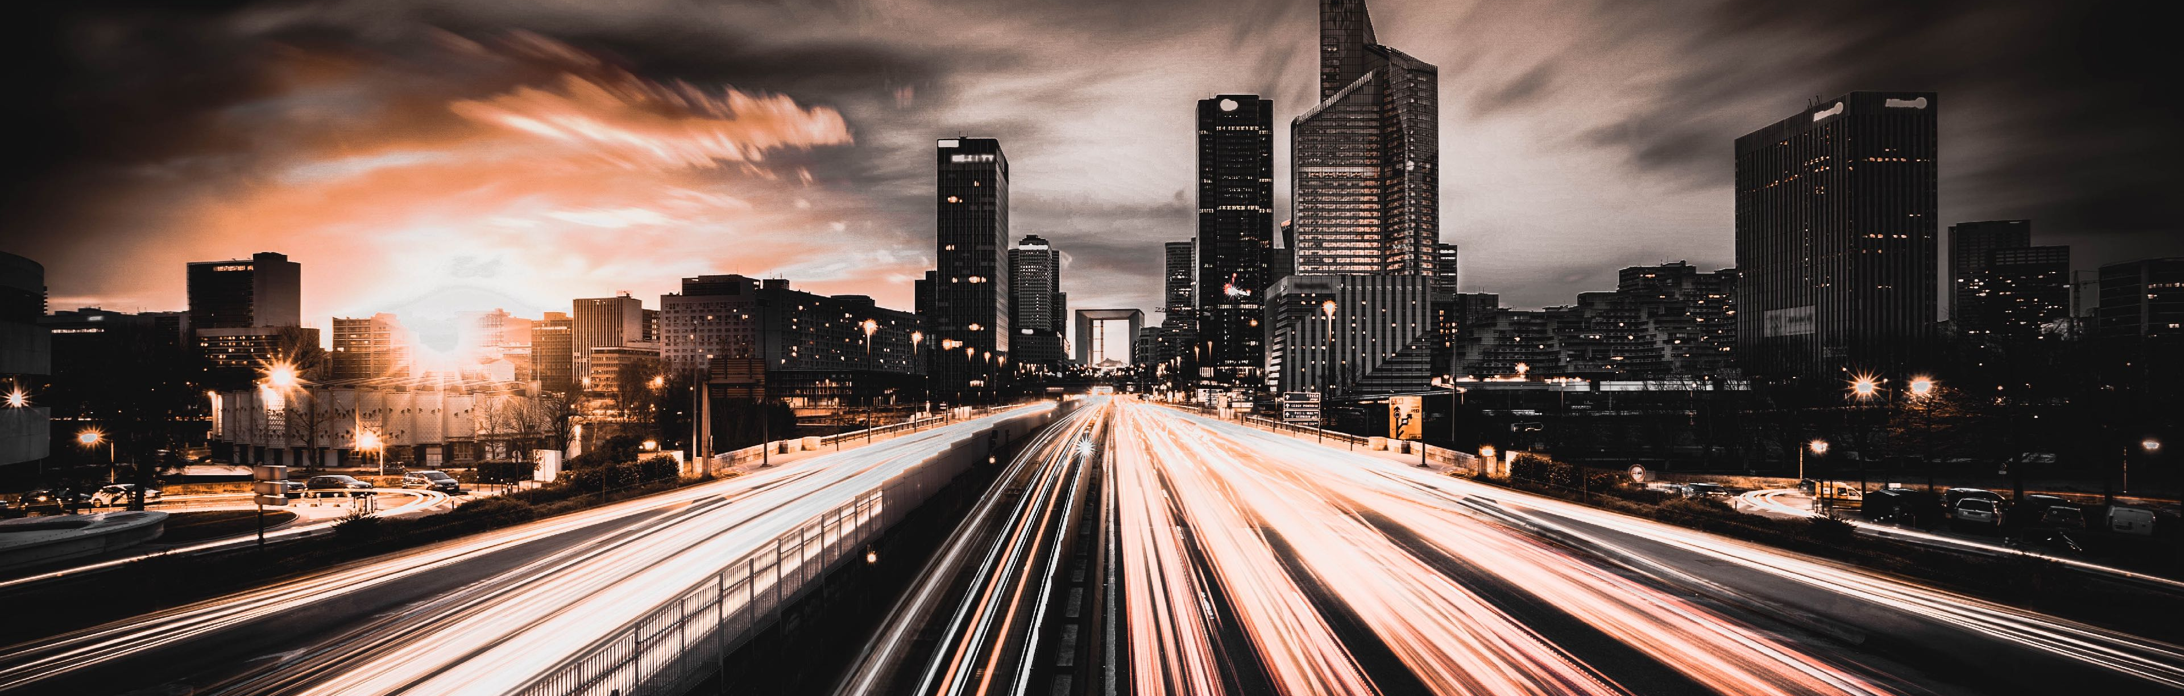
The Reason
The students are getting late to college day by day and are even involving their friends to mark their attendance, which is diverting them from studies.
Now, this inspires us to make a smart attendance system in this smart going world which can identify the student using computer vision and mark the attendance automatically.

Slide 5

Attendance
Management System
A smart system that has the following characteristics:
Fast & Unique Face Detection
Automatic Attendance Logger
Secure and Scalable
GUI based Application

Slide 6
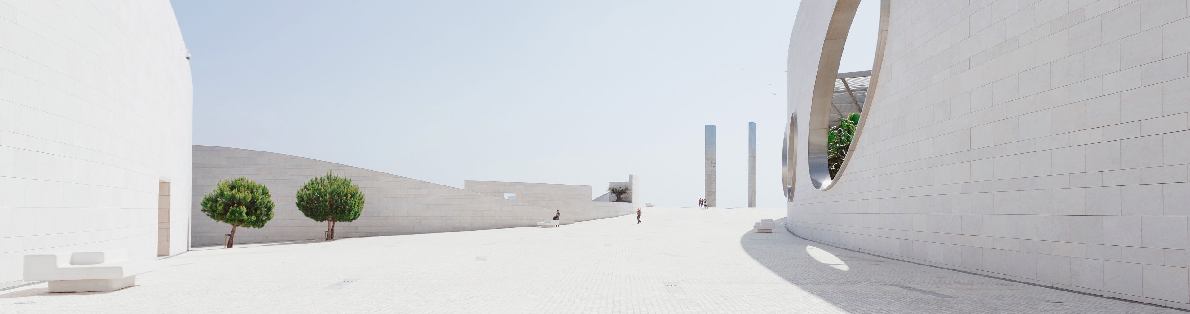
6
The Strategy
A smart attendance system that makes management easier.
The Application allows the user to mark attendance of each student.
Fast & Unique Face Detection
Automatic Attendance Logger
Identifies faces irrespective of its facial characters
Automatically marks the attendance for each student
Secure and Scalable
GUI based Application
Scans one face at a time, and has the capability to extend more features.
Simple UI based application for easy to use interface.

Slide 7
Goals
-Improve and organize the process of track manage student attendance
-increase privacy and security.
Our Goals and Vision
Vision
-better making the picture quality.
- recognition of the trouble making activities in the class that creates a notice to victim and notice to faculty.

Slide 8








Tools & Languages Used
Spyder
PYTHON
SUBLIME TEXT
Tkinter

Slide 9
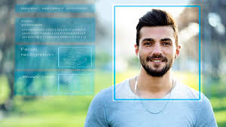
This System:
Face recognition is the most natural biological features recognition technique according to the cognitive rule of human beings. It’s algorithms is ten times more complex than fingerprint algorithm
This module was implemented using OpenCV which will help us in detection of faces along with the GUI interface.

Slide 10
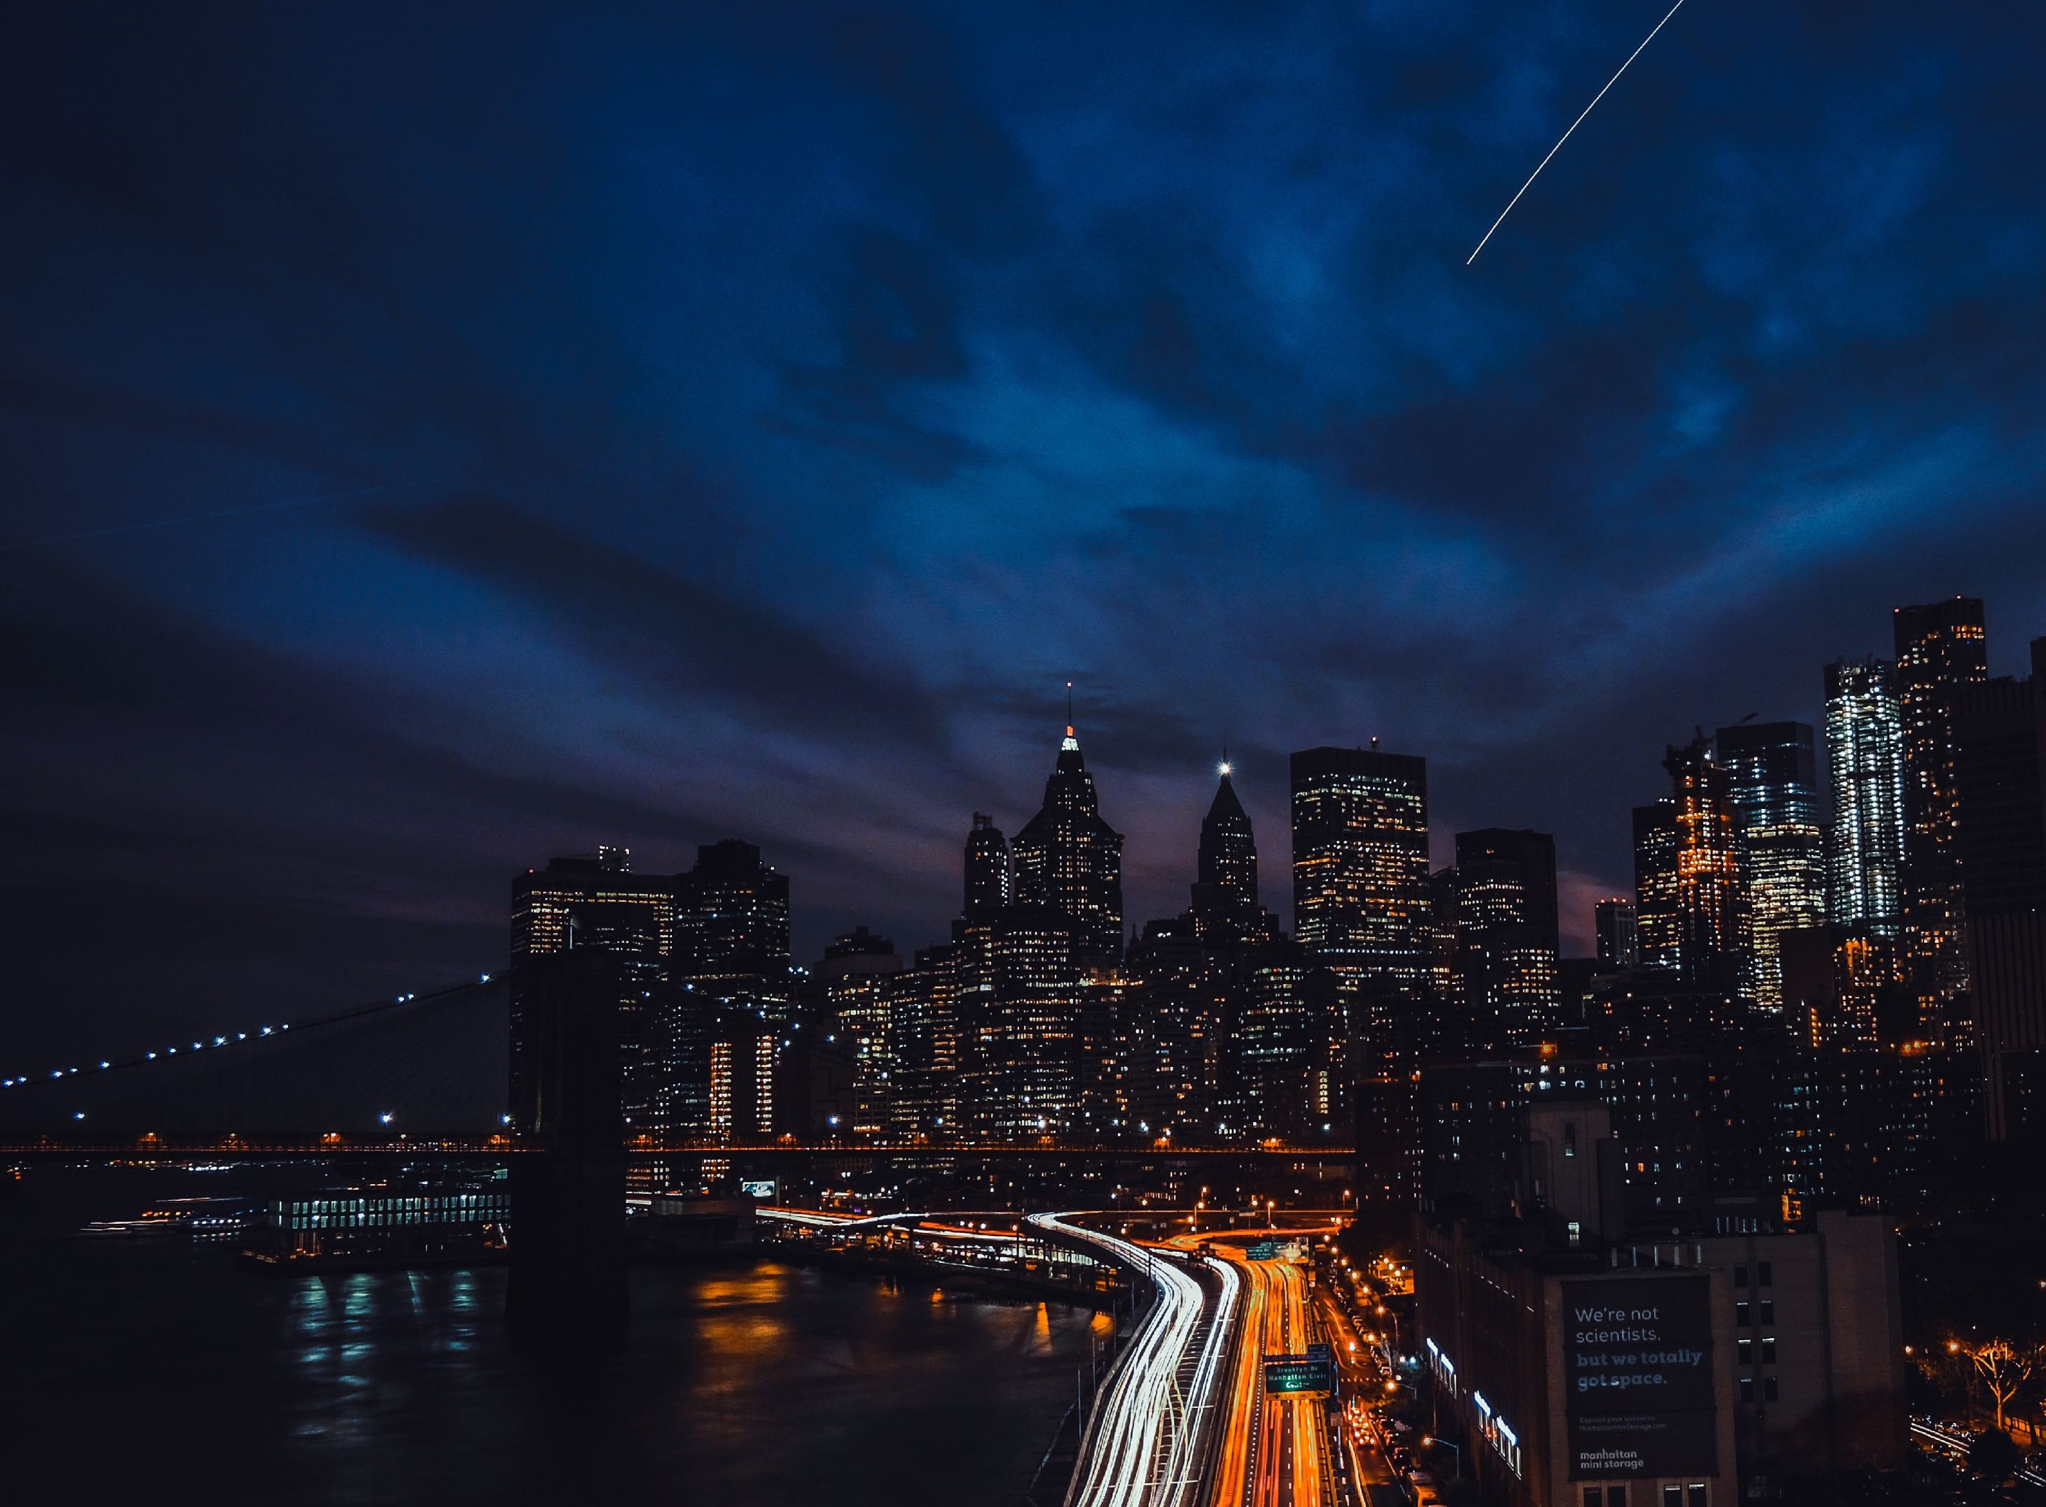
How it works?
System will allow authenticated user to login to the system.
It allows to mark the attendance via facial recognition technique.
The detection of faces is done using webcam.
Updates the attendance records when gets recognized.

Slide 11

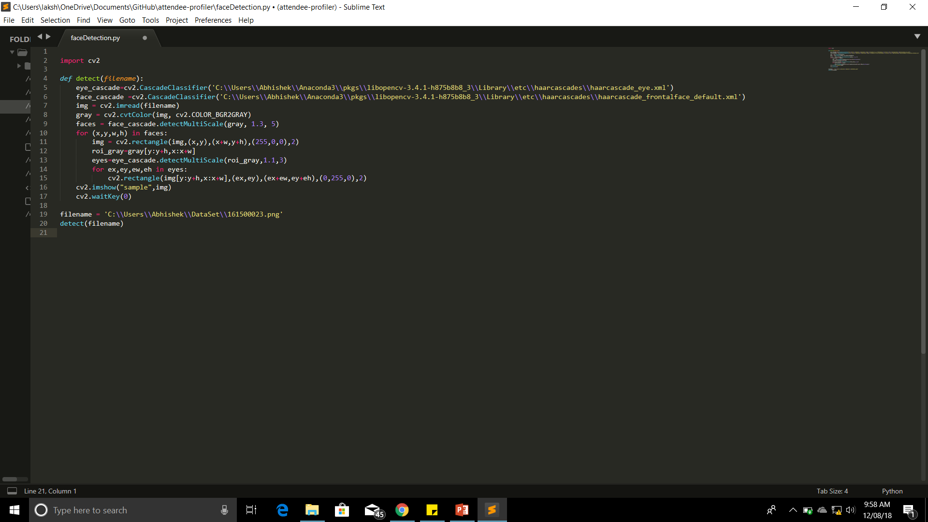
The Code: Detection
The backend
CODE
hghgfgfgfgfgfg
smart_main_2.py

Slide 12
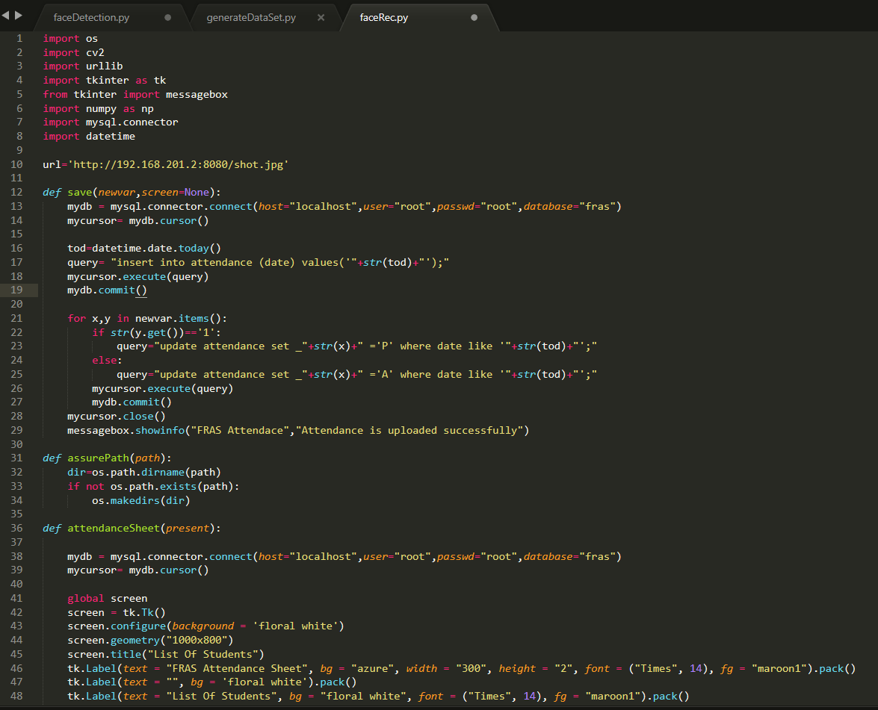
The Code: Recognition
The backend
CODE
hghgfgfgfgfgfg
smart_main_2.py

Slide 13
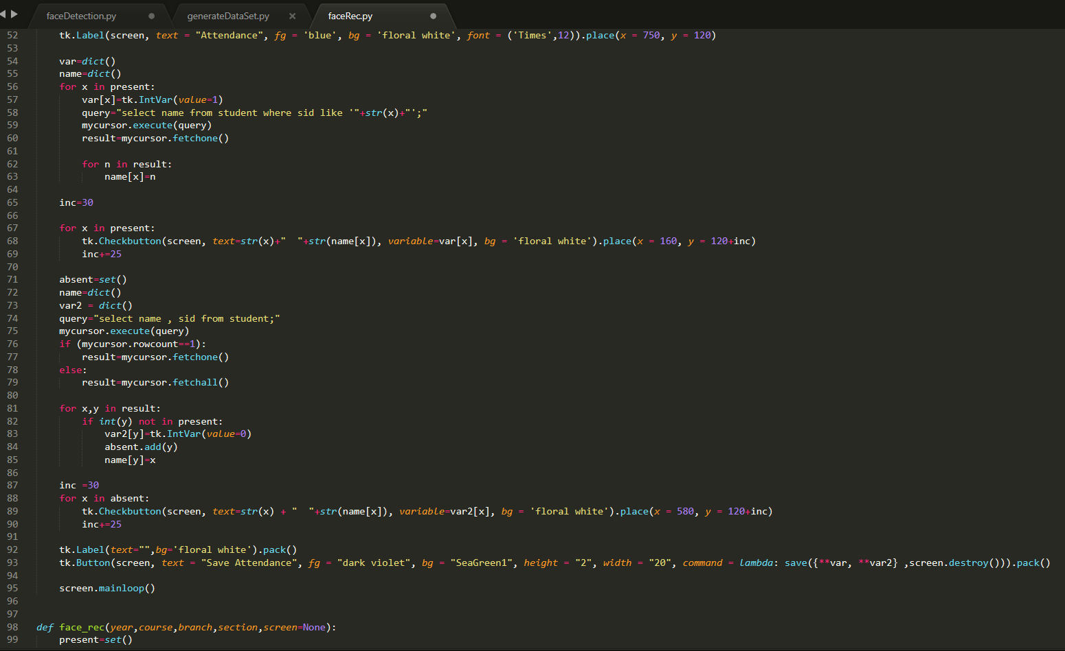
The Code: Recognition
The backend
CODE
hghgfgfgfgfgfg
smart_main_2.py

Slide 14
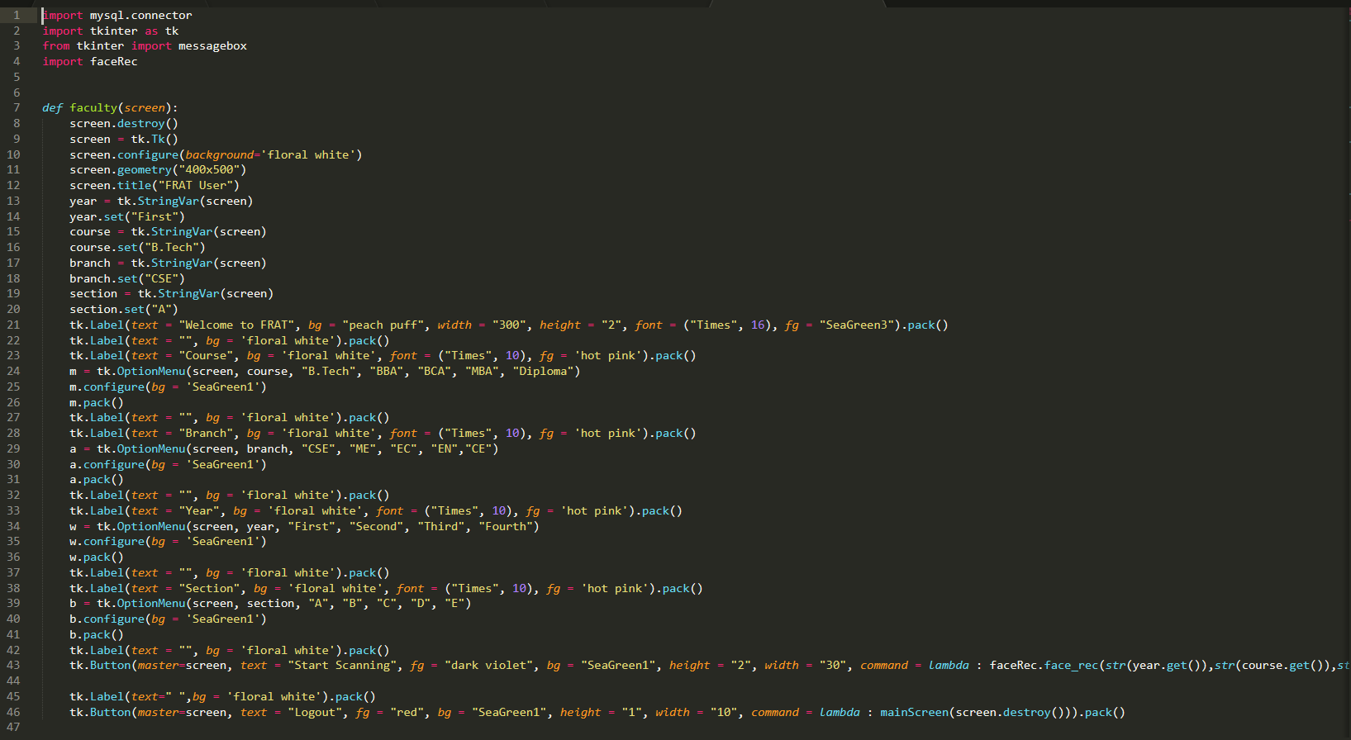
The Code: GUI
The backend
CODE
hghgfgfgfgfgfg
smart_main_2.py

Slide 15
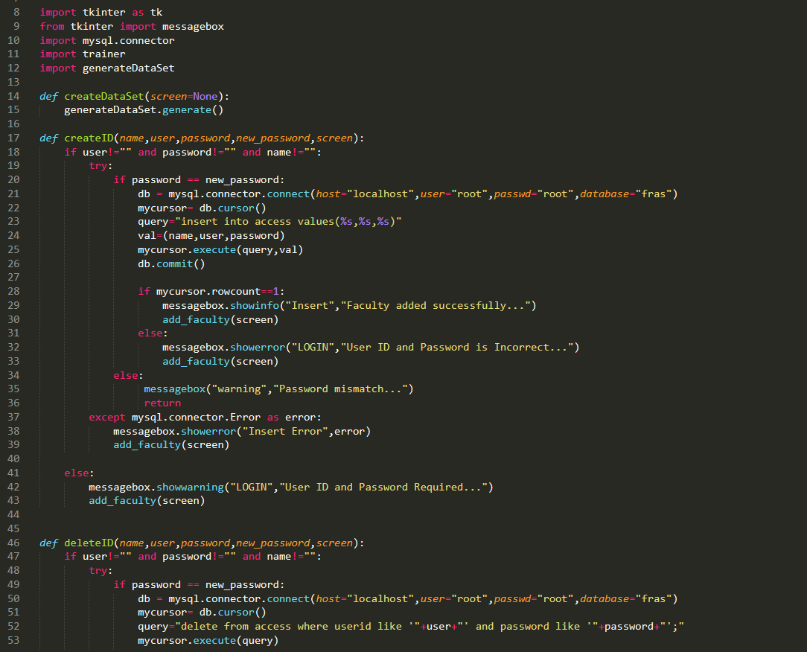
The Code: GUI
The backend
CODE
hghgfgfgfgfgfg
smart_main_2.py

Slide 16
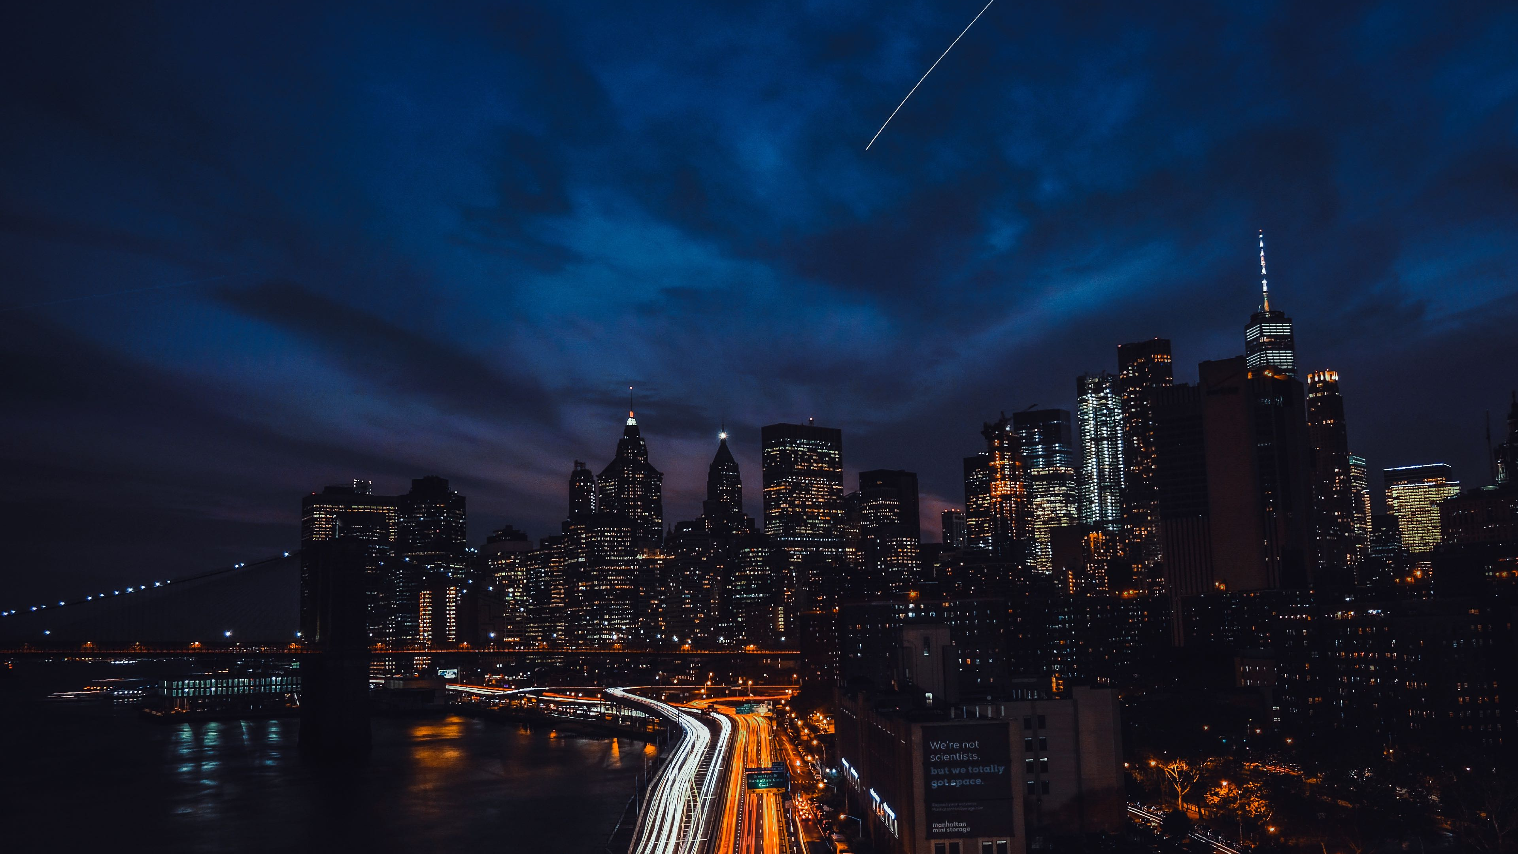
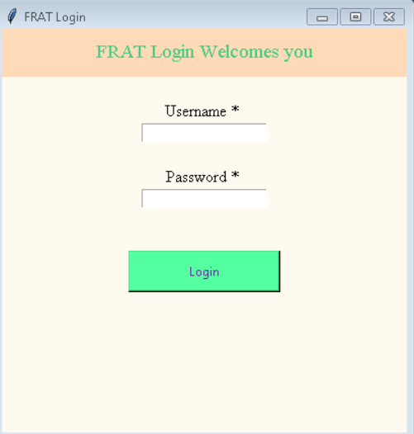
GUI
Application

Slide 17
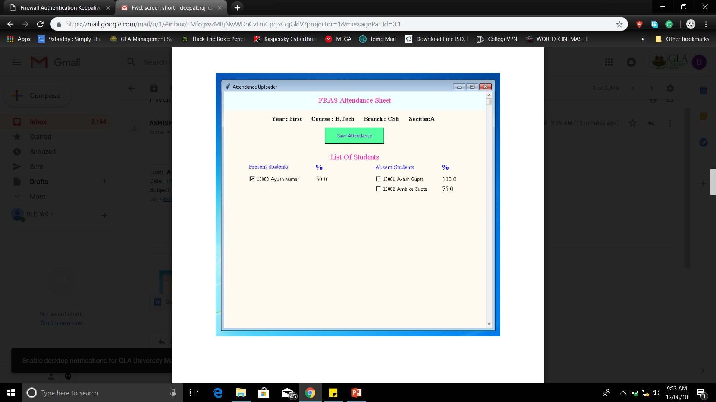
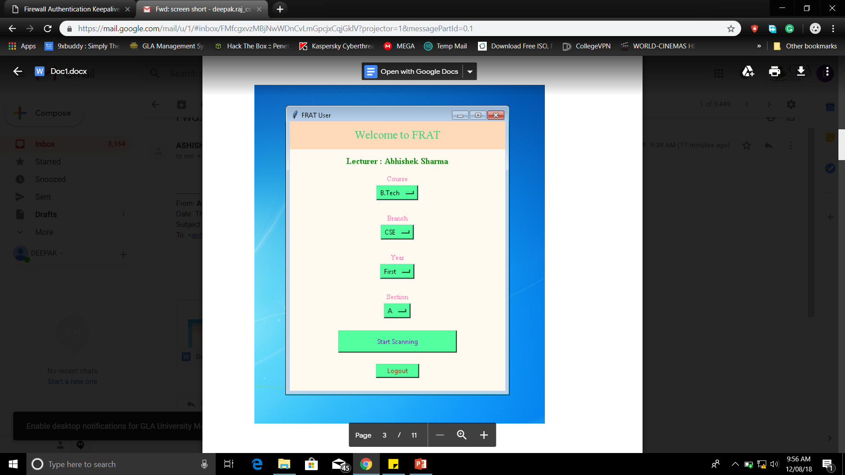
Application Screens

Slide 18
Any Queries?

Slide 19

Thank You!

